Slide 1

MAJOR PROJECT FINAL PRESENTATION ON TOPOLOGY OPTIMISATION OF AEROSPACE FIN USING GENERATIVE DESIGN
SUBMITTED BY
ANUSHA NAMPALLY
201700556
Mechanical

Slide 2
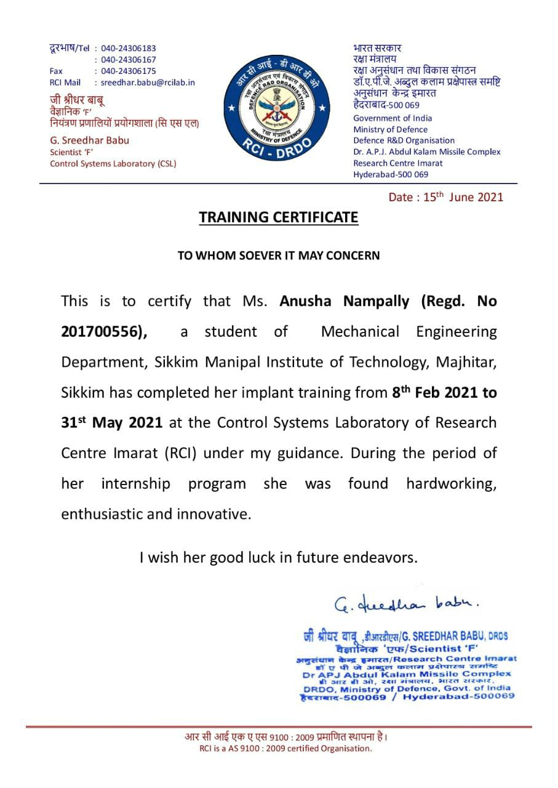
CERTIFICATION
This is the certification provided by the scientist under whom I was working as an Intern for my Major Project.

Slide 3
CONTENTS
INTRODUCTION
SOFTWARES USED FOR MODELING, SIMULATION AND TOPOLOGY OPTIMISATION
NEED & OBJECTIVE OF THE PROJECT
MY PROGRESS
MODELLING OF AEROSPACE FIN
MESHING OF 3D MODEL
STATIC ANALYSIS IN SOLIDWORKS
STATIC ANALYSIS IN ANSYS
TOPOLOGY STUDY
DESIGN OPTIMISATION AFTER TOPOLOGY STUDY
STATIC ANALYSIS OF REDESIGNED MODEL
COMPARATIVE SIMULATION STUDY OF NON-LINEAR ANALYSIS BEFORE AND AFTER TOPOLOGY STUDY
OUTCOME & ANALYSIS

Slide 4
I. INTRODUCTION
Topology Optimisation is a method that optimizes material layout within a given design space, for a
given set of loads, boundary conditions and constraints with the goal of maximizing the performance
of the system.
In this project, my main focus is on 3D modelling, simulation study and topology optimisation on
the aerospace fin is carried out by using ansys software
And generated the report of simulation study.
And generated new design model as per the topology optimisation results to arrive at the best
possible shape keeping weight reduction where strength and deflection should be matching with the
existing one.

Slide 5
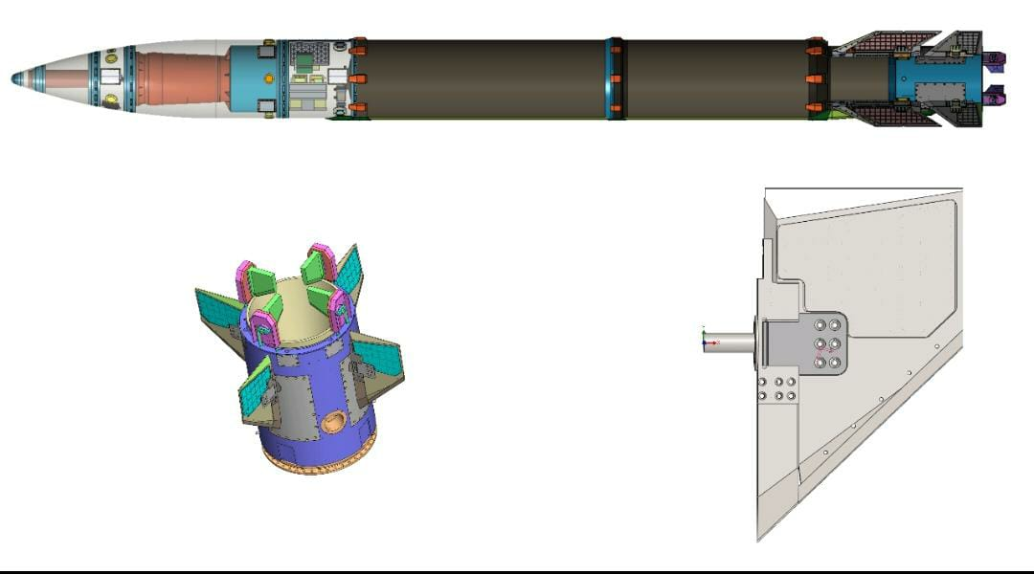

Slide 6
II. SOFTWARES USED FOR MODELING, SIMULATION AND TOPOLOGY OPTIMISATION
SOLIDWORKS(2019):
Solidworks is a 3D solid modeling software which allows users to develop full solid models in a simulated
environment for both design and analysis.
Finite element analysis (FEA) is the modeling of products and systems in a virtual environment, for the
purpose of finding and solving potential (or existing) structural or performance issues. FEA is the practical
application of the finite element method (FEM), which is used by engineers and scientist to mathematically
model and numerically solve very complex structural, fluid, and multiphysics problems.
ANSYS :
ANSYS is a general-purpose software, used to simulate interactions of all disciplines of physics, structural,
vibration, fluid dynamics, heat transfer, topology study and electromagnetic for engineers.
Ansys publishes engineering analysis software across a range of disciplines as follows Finite element
analysis structural analysis computational fluid dynamics Heat transfer Explicit dynamic analysis (worked on Topology Optimization using ANSYS).

Slide 7
III. NEED & OBJECTIVE OF THE PROJECT
Mostly used in aerospace applications in-order to reduce the weight/mass of the aircraft which directly increases the velocity and efficiency.
Weight is premium in Aerospace industry, every gram of weight added will reduce the range of fuel consumption.
Need : improvement of existing aerospace control surface for better performance.
Objective : To reduce the weight keeping same material, manufacturing feasibility and cost, in view without change in aerodynamic parameters of a control surface used to steer the aerospace vehicle.

Slide 8
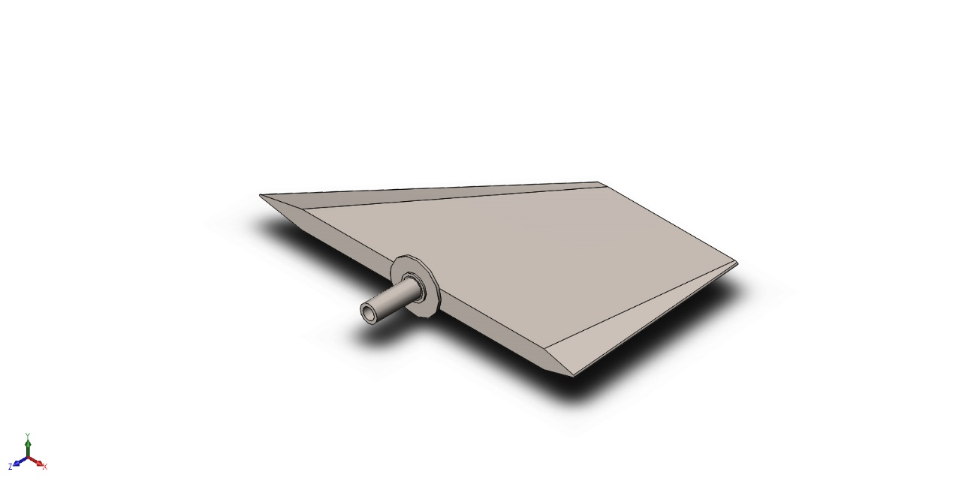
IV. MY PROGRESS
1. MODELLING OF AEROSPACE FIN
3D model of aerospace fin designed with the help of solidworks modelling software with the
existing measurements.

Slide 9
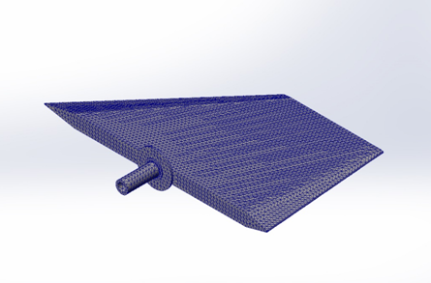
2. MESHING OF 3D MODEL
Meshing has been carried out before starting the simulation process of aerospace fin represent a
geometric object as a set of finite elements.
Mesh type | Solid Mesh
Mesher Used: | Standard mesh
Automatic Transition: | Off
Include Mesh Auto Loops: | Off
Jacobian points for High quality mesh | 4 Points
Element Size | 7.64202 mm
Tolerance | 0.382101 mm
Mesh Quality | High
Total Nodes | 67327
Total Elements | 41703
Maximum Aspect Ratio | 15.39
% of elements with Aspect Ratio < 3 | 96.9
% of elements with Aspect Ratio > 10 | 0.11
% of distorted elements(Jacobian) | 0
Time to complete mesh(hh;mm;ss): | 00:00:05

Slide 10
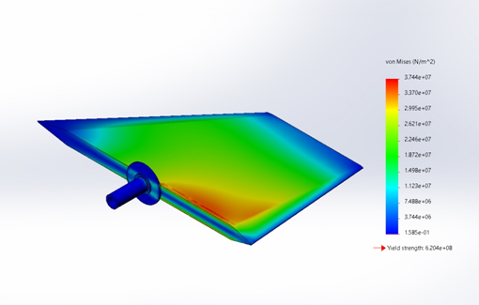
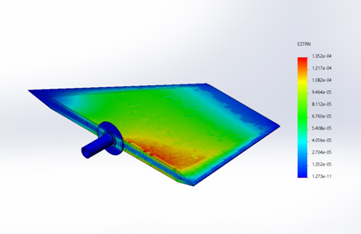
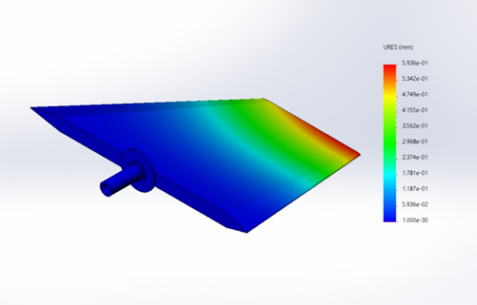
3. STATIC ANALYSIS IN SOLIDWORKS
I have performed the Static Analysis on the aerospace fin, using Solidworks Simulation Software,
and applied normal force is 15000N is applied . Results are obtained in the form of stress, strain and
displacement.
STRESS
STRAIN
DISPLACEMENT
NAME | TYPE | MIN | MAX
STRESS | von Mises Stress | 1.585e-01N/m^2 | 3.744e+07N/m^2
STRAIN | Equivalent Strain | 1.273e-11 | 1.352e-04
DISPLACEMENT | Resultant Displacement | 0.000e+00mm | 5.936e-01mm

Slide 11
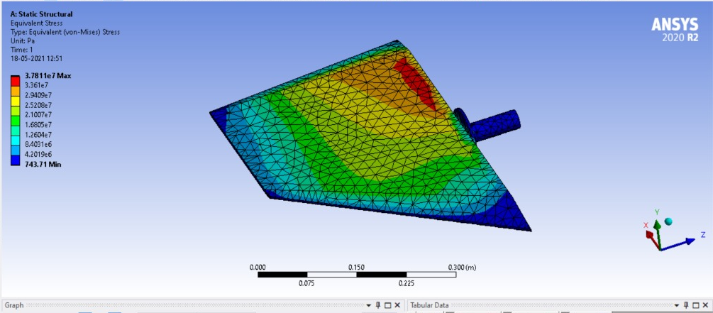
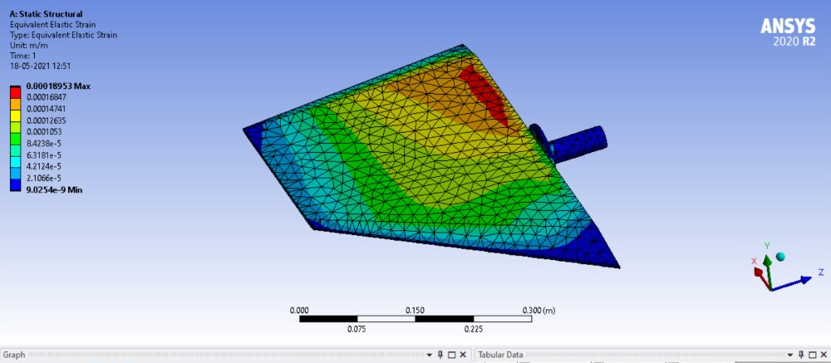
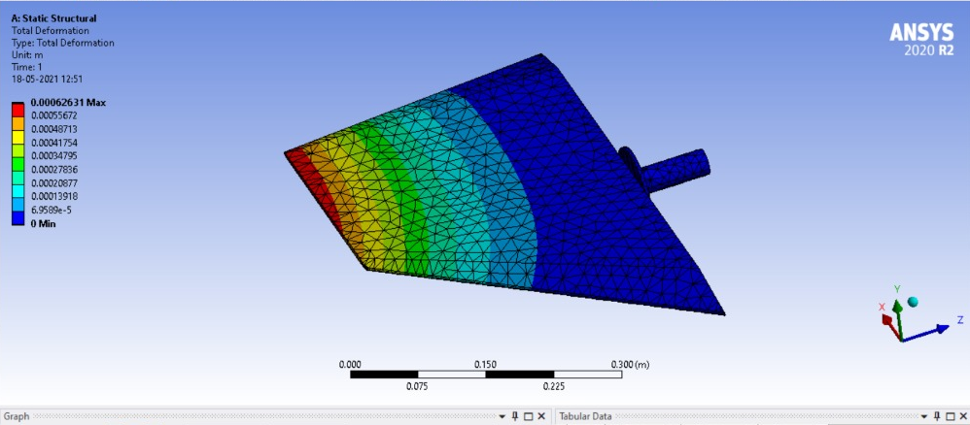
4. STATIC ANALYSIS IN ANSYS
For topology optimisation Static Analysis on the aerospace fin, using Ansys Software, and the load
of 15000N is applied . Results are obtained in the form of stress, strain and displacement.
STRESS
STRAIN
DISPLACEMENT
NAME | TYPE | MIN | MAX
STRESS (Pa) | von Mises Stress | 743.71 | 3.711e7
STRAIN (m/m) | Equivalent Strain | 9.0254e-9 | 0.00018953
DISPLACEMENT (m) | Resultant Displacement | 0 | 0.00062631

Slide 12
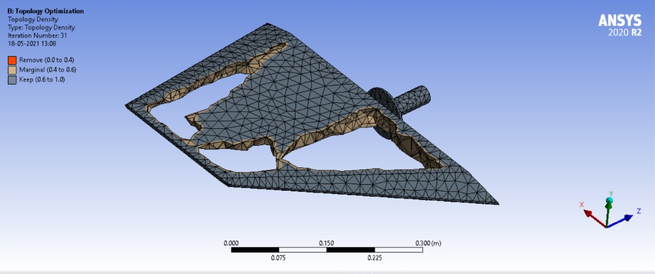
5. TOPOLOGY STUDY
Topology optimisation is carried out on the aerospace fin, using Ansys Software, to find maximum
material from the fin when the load of 15000N is applied to it.
This is the possible model after topology study.

Slide 13
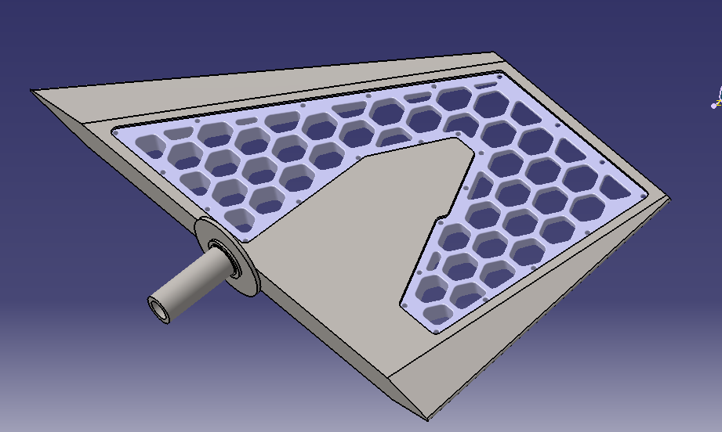
6. DESIGN OPTIMISATION AFTER TOPOLOGY STUDY
After Topology optimisation is carried out on the aerospace fin, redesigned the model with
honeycomb patterns for more strength when the load of 15000N is applied to it.
This is the possible model after topology study.

Slide 14
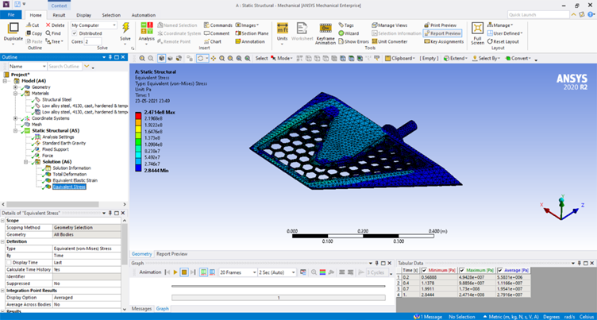
7. STATIC ANALYSIS OF REDESIGNED (Generative) MODEL
Elastic stress :
This is the maximum stress obtained, when the fin is subjected to 15000N load.

Slide 15
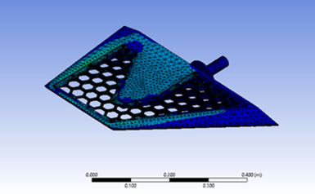
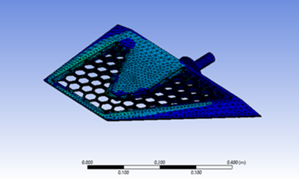
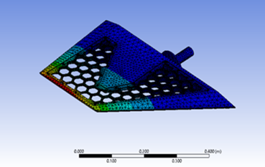
STATIC ANALYSIS IN ANSYS
STRESS
STRAIN
DISPLACEMENT
NAME | TYPE
STRESS | von Mises Stress
STRAIN | Equivalent Strain
DISPLACEMENT | Resultant Displacement

Slide 16
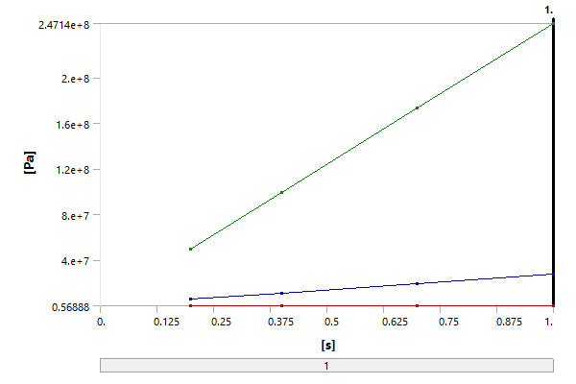
Elastic stress :
The graph represents the no of iteration done between stress and time.
Time [s] | Minimum [Pa] | Maximum [Pa] | Average [Pa]
0.2 | 0.56888 | 4.9428e+007 | 5.5831e+006
0.4 | 1.1378 | 9.8856e+007 | 1.1166e+007
0.7 | 1.9911 | 1.73e+008 | 1.9541e+007
1. | 2.8444 | 2.4714e+008 | 2.7916e+007

Slide 17
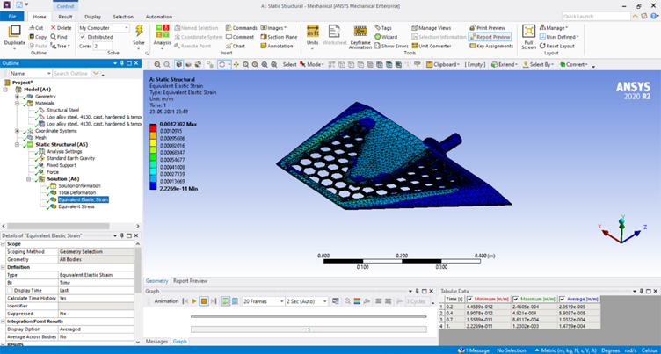
Elastic strain :
This is the maximum strain obtained, when the fin is subjected to 1500N load.

Slide 18
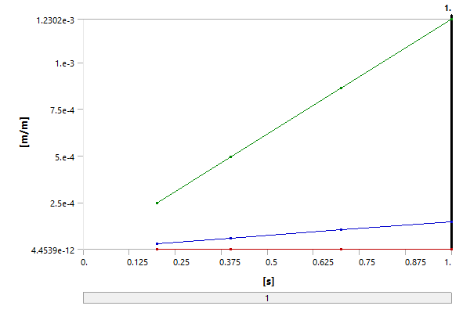
Elastic strain :
The graph represents the no of iteration done between strain and time
Time [s] | Minimum [m/m] | Maximum [m/m] | Average [m/m]
0.2 | 4.4539e-012 | 2.4605e-004 | 2.9519e-005
0.4 | 8.9078e-012 | 4.921e-004 | 5.9037e-005
0.7 | 1.5589e-011 | 8.6117e-004 | 1.0332e-004
1. | 2.2269e-011 | 1.2302e-003 | 1.4759e-004

Slide 19
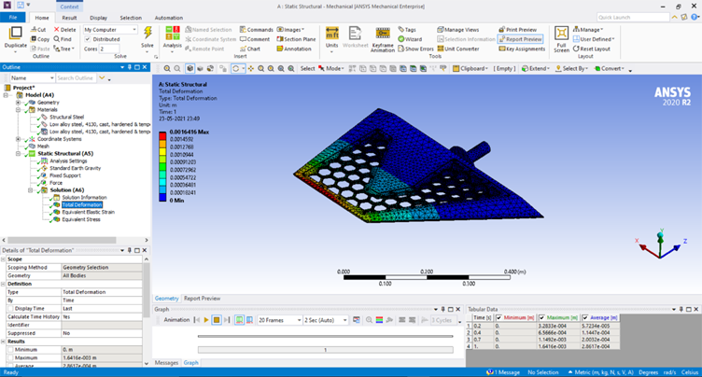
Total deformation:
This is the total deformation occurred, when the fin is subjected to 1500N load.

Slide 20
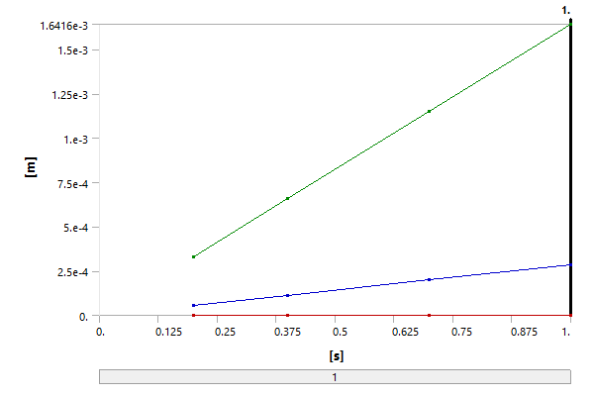
Elastic stress :
The graph represents the no of iteration done between total deformation and time
Time [s] | Minimum [m] | Maximum [m] | Average [m]
0.2 | 0. | 3.2833e-004 | 5.7234e-005
0.4 |  | 6.5666e-004 | 1.1447e-004
0.7 |  | 1.1492e-003 | 2.0032e-004
1. |  | 1.6416e-003 | 2.8617e-004

Slide 21
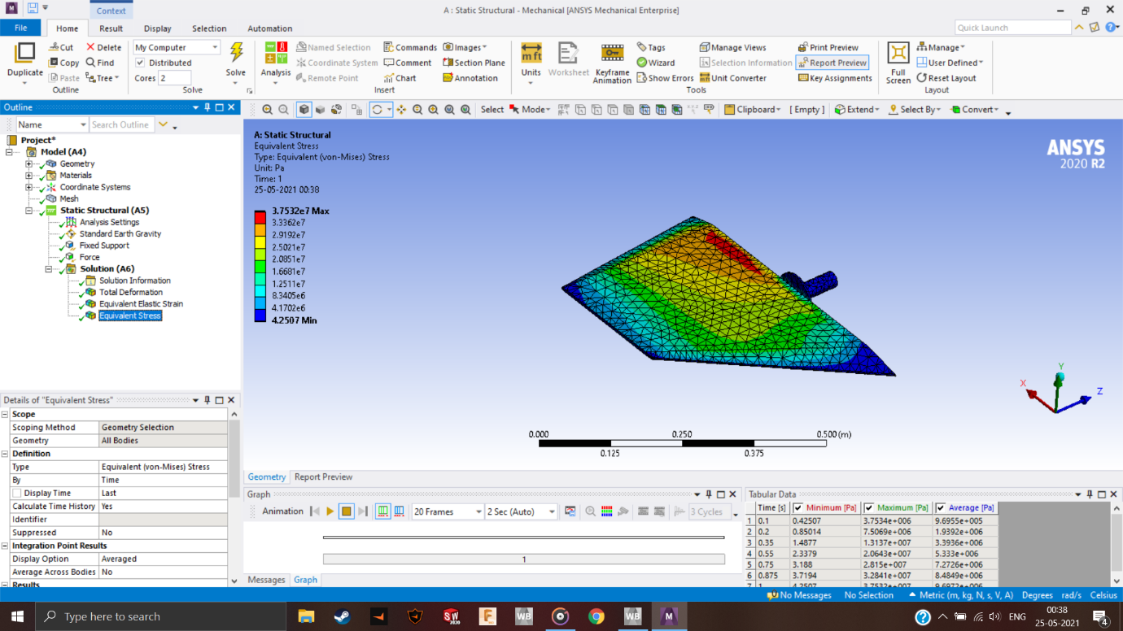
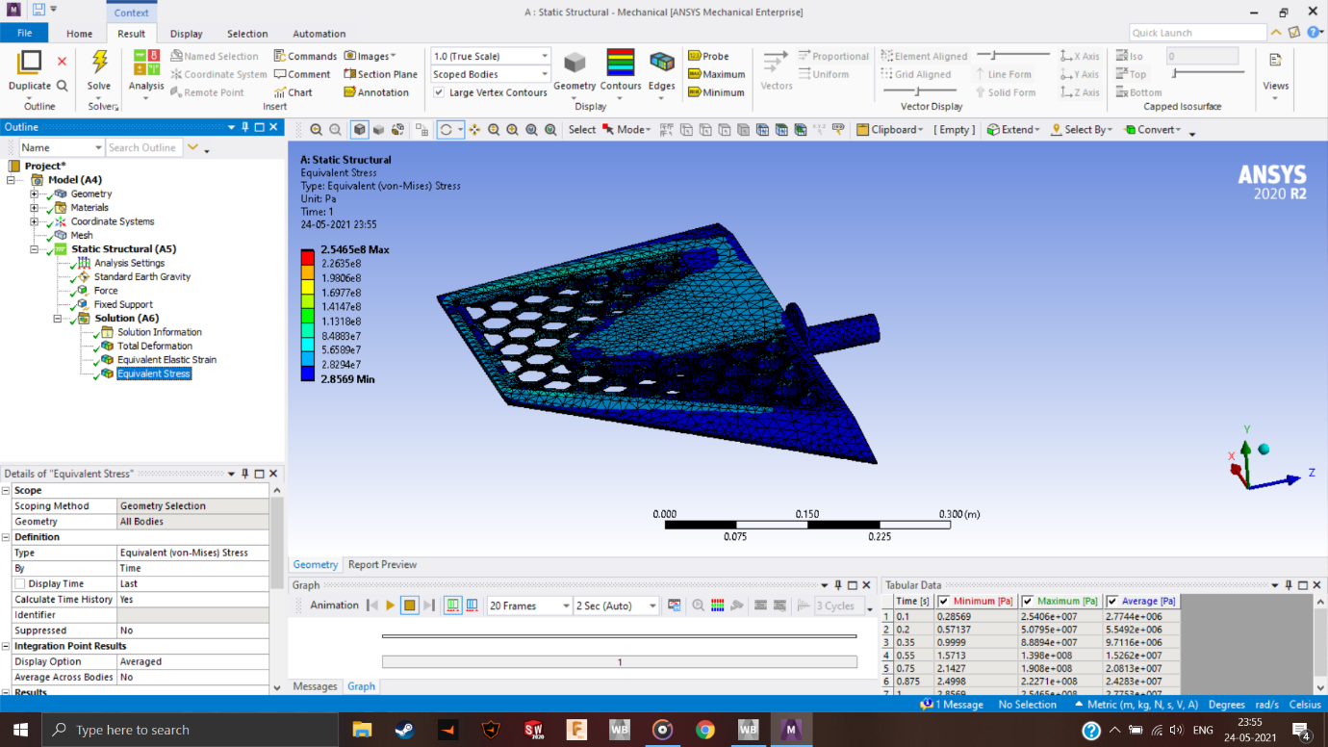
8. COMPARATIVE SIMULATION STUDY OF NON LINEAR ANALYSIS BEFORE AND AFTER TOPOLOGY STUDY
Elastic stress :
This is the comparative stress results of non linear analysis, when the load (1500N) is same for both
actual design model and redesigned model (after topology study).

Slide 22


Elastic strain :
This is the comparative strain results of non linear analysis, when the load (1500N) is same for both
actual design model and redesigned model (after topology study).

Slide 23
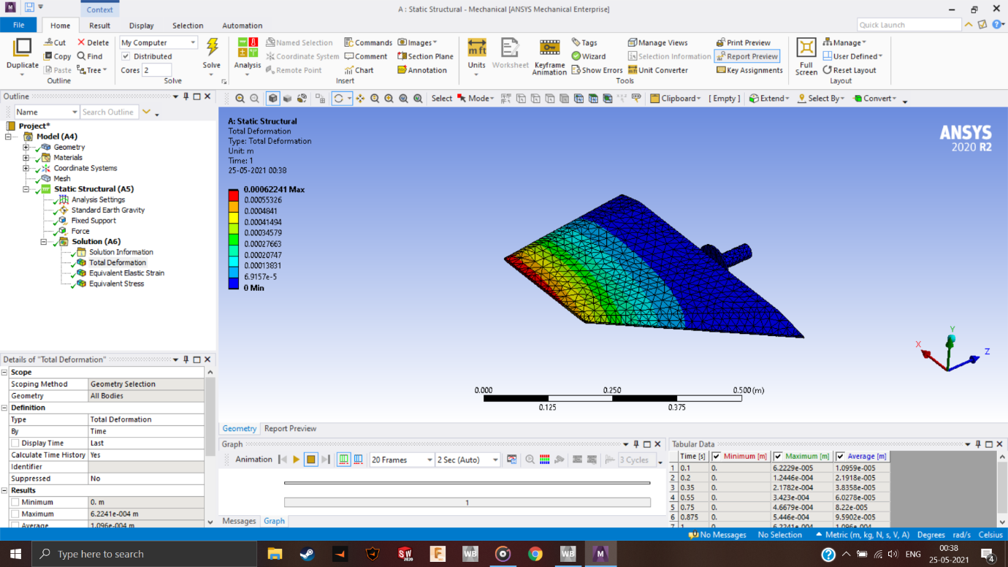
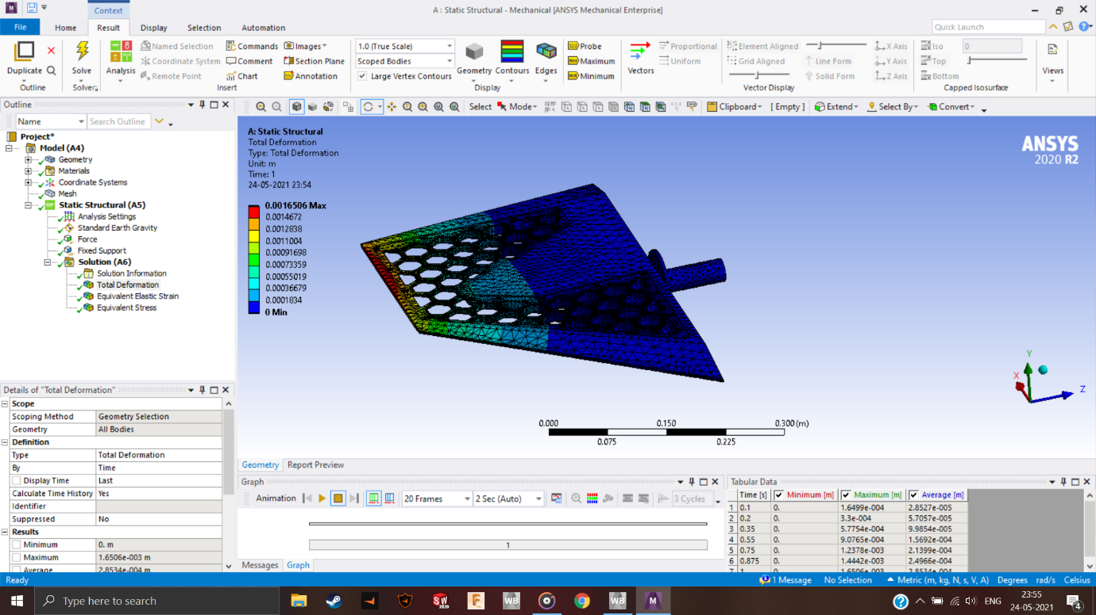
Total deformation :
This is the comparative deformation results of non linear analysis, when the load (1500N) is same for both actual design model and redesigned model (after topology study).

Slide 24
9. OUTCOME
Cost optimisation: As the extra weight is removed, the extra material is removed which is directly proportional to minimisation of cost.
Performance of the system is maximised
Extra/unnecessary weight/mass is minimised(size optimisation).
A shortened design process.

Slide 25
ANALYSIS
Volume reduction after Topology Optimization = 22 % (data obtained from Analysis)
Cost reduction per fin:
Actual cost of Alloy Steel per kg = Rs 50/-
Weight of fin (actual) = 20 kg
Total cost of fin = 20*50 = Rs 1000/-
Reduction in weight = (22/100) *20 = 4.4 kg reduction
The weight of the fin after optimization = (20-4.4) = 15.6 kgs
Cost of the fin after optimization = (15.6*50) = Rs 780/-
Reduction in cost after Optimization = (Total cost of fin-Cost of fin after Optimization)
= (1000-780) = Rs 220/- for each fin.
% Reduction in cost = (Reduction in cost*100)/Total cost of fin = (220*100)/1000 = 22%

Slide 26
THANK YOU

